Slide 1

Terraform 101
A beginners guide, by a beginners guide
https://github.com/johnverbiest/Terraform101-KnowledgeShare

Slide 2




Whoami?
Me!
Code monkey @ Informat
An
Eva
Balloon
Taking first steps @
John Verbiest
Jverbiest@infinitaslearning.com
john@johnverbiest.be
Living in Menen, Belgium
Magic!

Slide 3
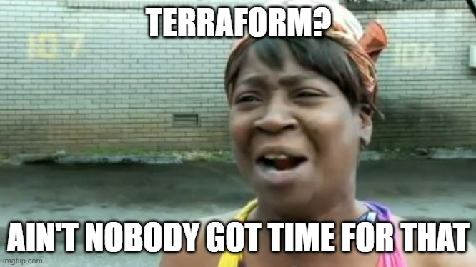
What’s on the agenda?
Terrawhat?
Like for real, what is terraform?
Terrawhy?
Like why would i even bother?
Terrahow?
Like how the flagnot does this work?

Slide 4

Terrawhat?
Infrastructure as code provider
Alternative: AzureRm
Uses the code to change the infrastructure to reflect the code (declarative)
Integrates in build & deploy pipelines
Industry standard
Free (paying gives you some management stuff)

Slide 5

Terrawhy?
Infrastructure is version controlled
Easier to manage
Redeploy to different environments (test, dev, qa, production, …) is peanuts when setup
Destroying an environment is supah easy without worrying about destroying too much or too little
We like code!

Slide 6
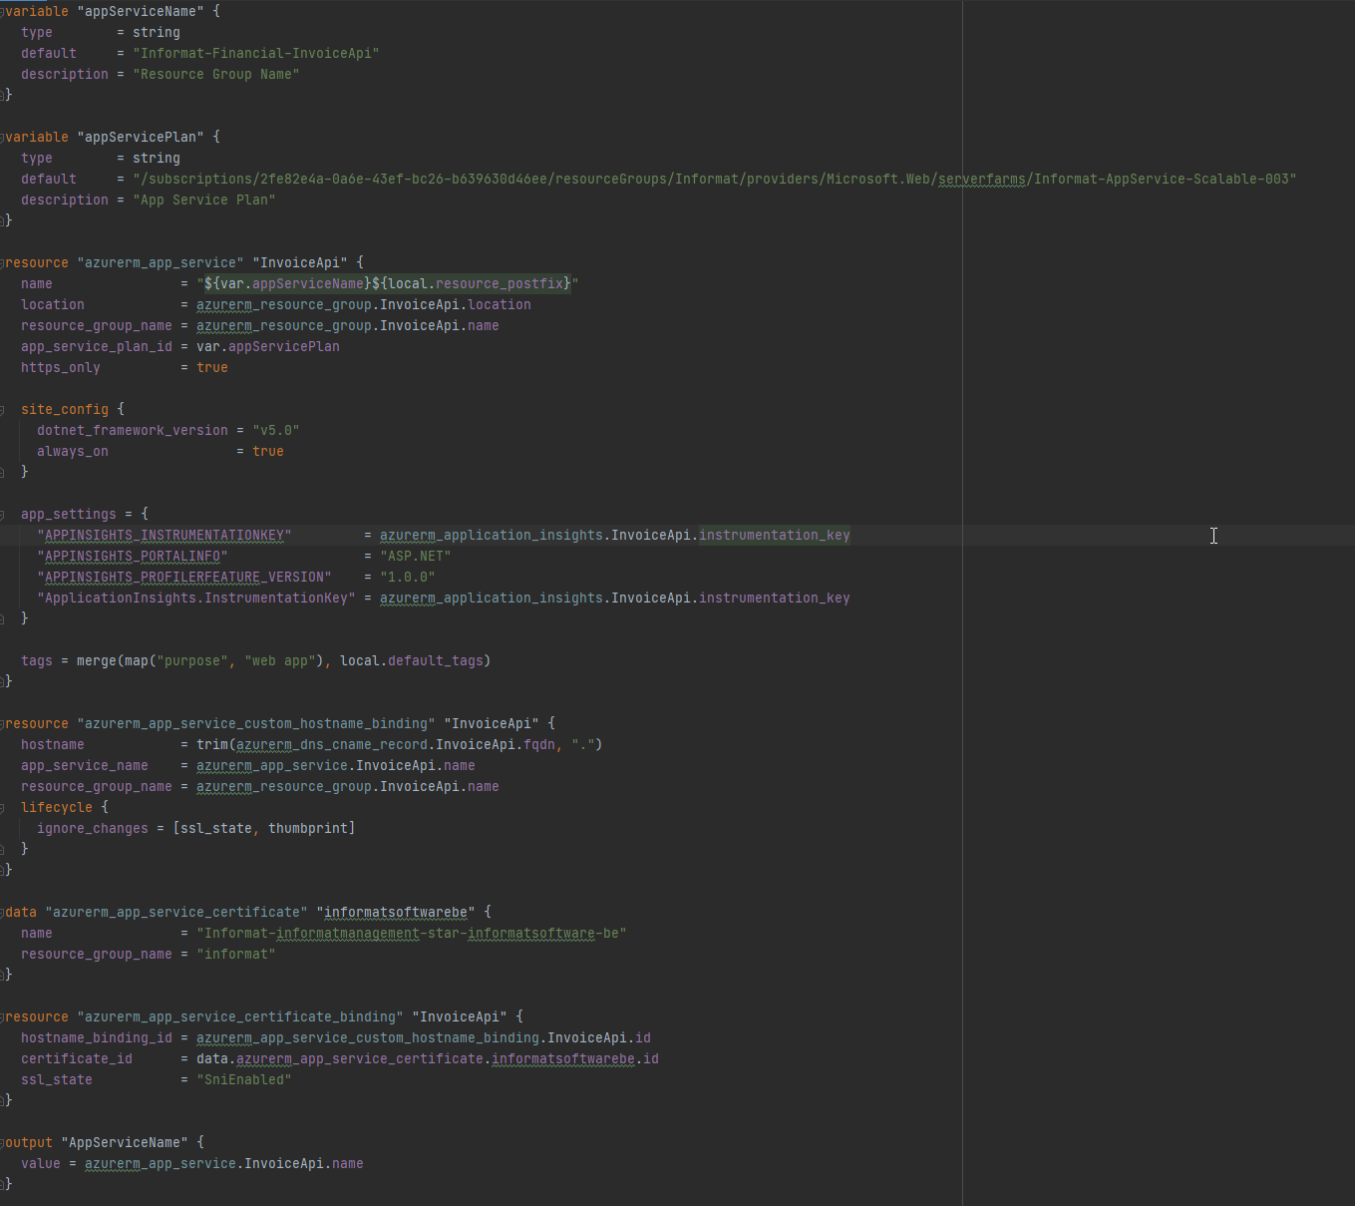
Terrahow
By showing some examples?

Slide 7


Slide 8
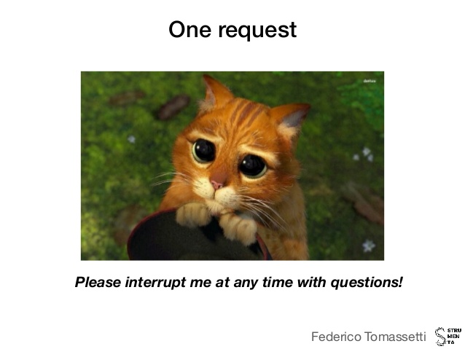
DEMO-O-CLOCK!
Doing stuff one step at a time!
get the powerpoint and demo files here
https://github.com/johnverbiest/Terraform101-KnowledgeShare

